Slide 1

Virtual Reality Welding at Hull College.
By Mark Shannon.

Slide 2
Introduction.
Mark Shannon.
Curriculum Leader for Fabrication, Welding and Vehicle Body Repair at Hull College.
Work at the School of Motor Vehicle and Engineering.
Goole College and Harrogate College are also part of H.C.U.K.
Approximately 25,000 full time students and 15,000 part time students enrol each year.

Slide 3
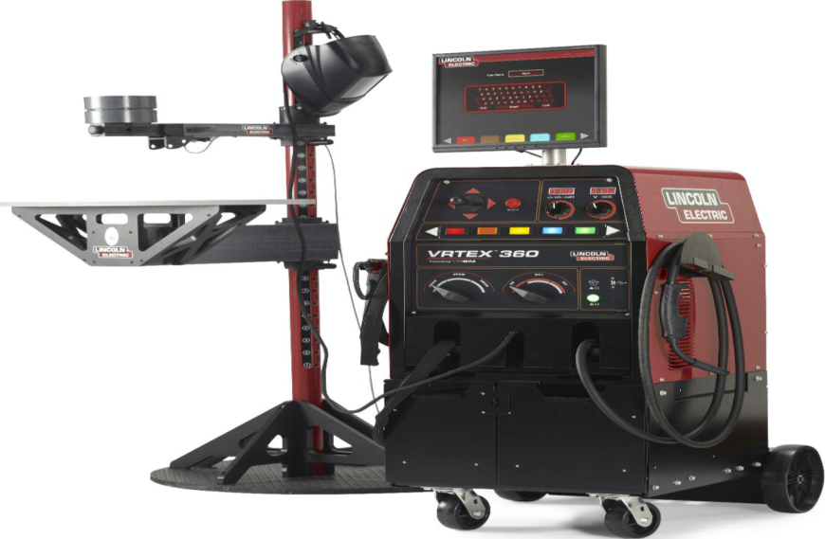
Virtual Reality Welding Simulator.

Slide 4
How did I hear about it?
Word of mouth.
Researched it on the Internet.
Visited Lincoln Electric’s HQ for a demonstration.
Discussed it with my Head of School.
A business case was put to our Senior Leadership Team (SLT) who agreed that it was a good investment.

Slide 5
Functions.
MIG or MIG welding.
A variety of joints available.
A variety of positions available.
Built in training aids.
Instant feedback (strengths and areas for development easily identified).

Slide 6
Functions - MIG or MMA Welding.

Slide 7
Functions – Variety of Joints.

Slide 8
Functions – Variety of Joints.

Slide 9
Functions – Variety of Joints.

Slide 10
Functions – Variety of Joints.

Slide 11
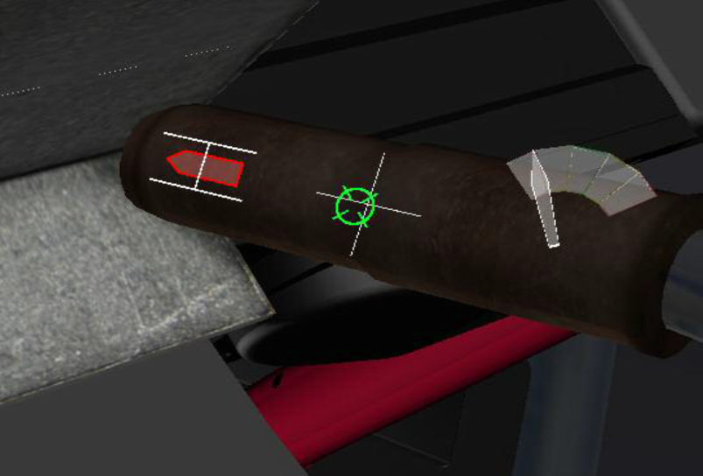
Functions – Built in training aids.

Slide 12
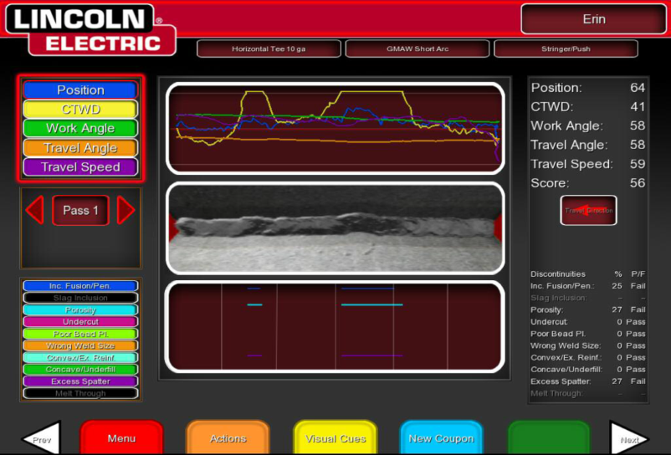
Functions – Instant feedback.

Slide 13
Student Feedback.
“Very useful in helping me practice different welding positions”
“Fun and interactive”
“I like the competition element as I want to get a better score than my friend”
“Quick and easy to set up meaning I can spend more time actually welding and if I make a mistake, I can just reset it and start again”

Slide 14
Benefits.
Very user friendly.
Very quick and easy to set up.
Uses no consumables.
Produces no harmful fumes.
No sparks or heat generated.

Slide 15
Teething Problems/Issues.
Very sensitive.
Viewing goggles in welding mask can be easily distorted.
Cannot be used for long periods of time.
Arm that holds the coupons to be welded could be shorter to allow a more comfortable welding position.

Slide 16
Plans for the future.
Integrate it fully into lessons.
Offer it as a training aid for local employers.
Use it for Marketing purposes.
Produce inspection resources for the students.

Slide 17
Any questions?

Slide 18
Contact details.
Mark Shannon
mshannon@hull-college.ac.uk

